Slide 1
Weishang micro-boss
－A New E-Commerce Model
By Naam
shenqingwei@hotmail.com

Slide 2


CONTENT
What is WeChat?
What is Microboss?
How to do Microboss?

Slide 3

What is WeChat?

Slide 4




1.Definition
•A Chinese social media application developed by Tencent;
(instant messaging,commerce and payment services)
•It was first released in 2011,and at the end of 2016,it was one
of the largest standalone messaging apps by monthly active
users,with over 889 million active users.

Slide 5
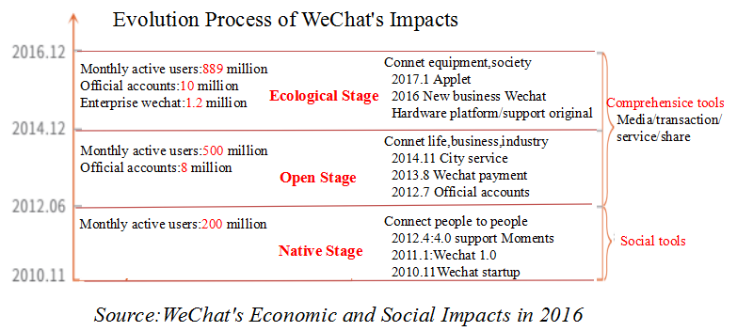
Flora & Elena

Slide 6
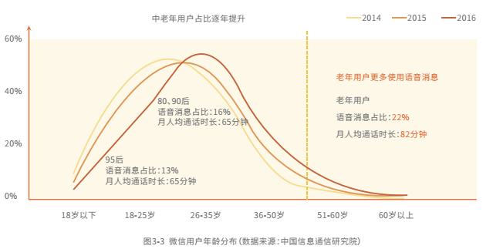
WeChat Users Age Distribution

Slide 7
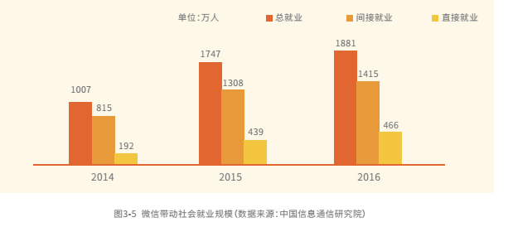
WeChat Promote Scale of Employment
Totally
Indirectly
Directly
18.81 million
17.47 million
10.07 million

Slide 8
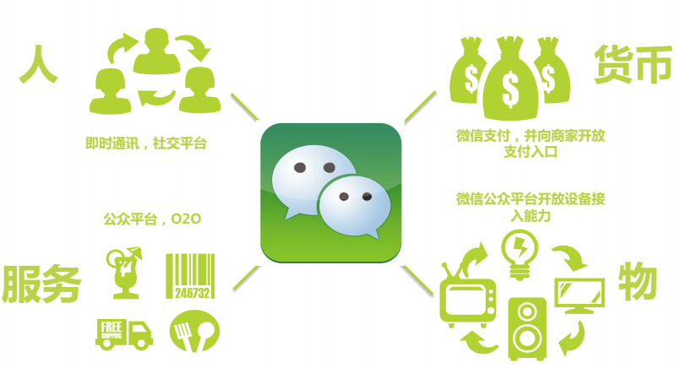
2.Function
Wechat gradually developed from a simple social tool to the people and people, people and service, people and business platform.
People: communicate eg.
Money:WeChat payment eg.
Service:online to offline eg.
Connnet with equipment eg.

Slide 9
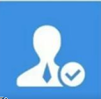


3.Three Parts in Wechat
Official Account
Wechat Moments
WeChat Micro Shop

Slide 10
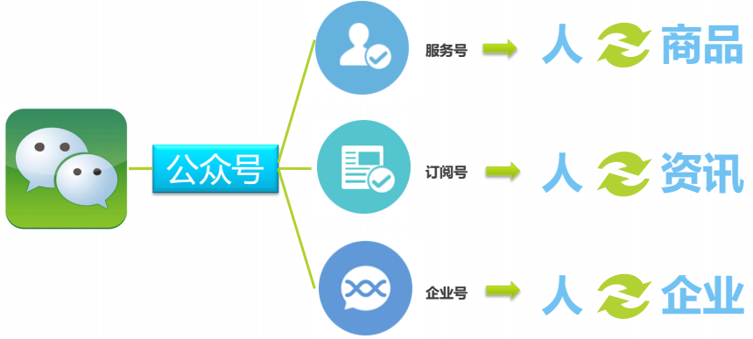
4.The Role of the Official Account in WeChat
service
subscriprions
WeChat enterprise
The official account could connect people with products,news and enterprise .

Slide 11
Account Type vs. Functionality
Account Type vs.Functionality | Subscription Account | Service Account
Message displayed in sessions list | No | Yes
Message displayed in subscription folder | Yes | No
Send 1 message per day | Yes | No
Send 4 messages per month | No | Yes
Direct communication with followers | Yes | Yes
Customized Interactive Menu | Yes | Yes

Slide 12
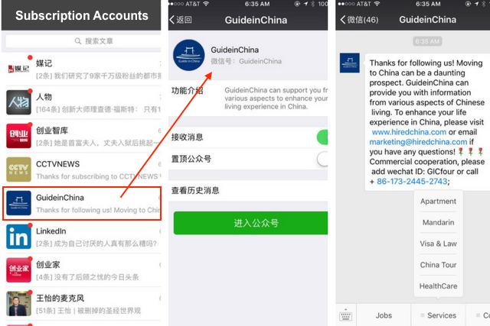
Subscript accounts sample

Slide 13
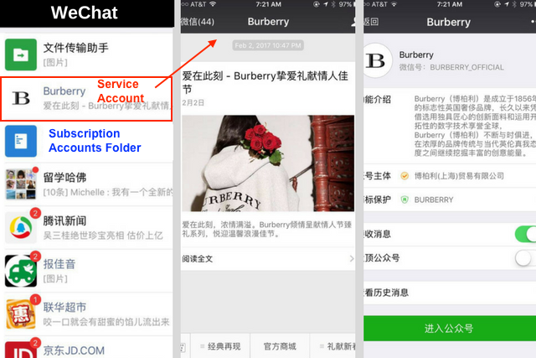
Service accounts sample

Slide 14
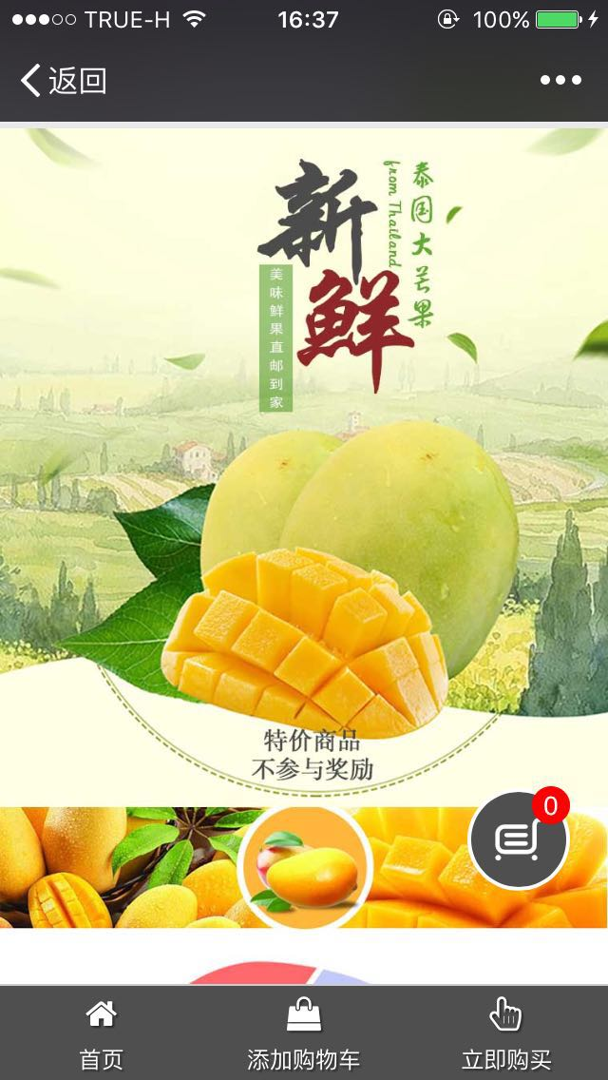
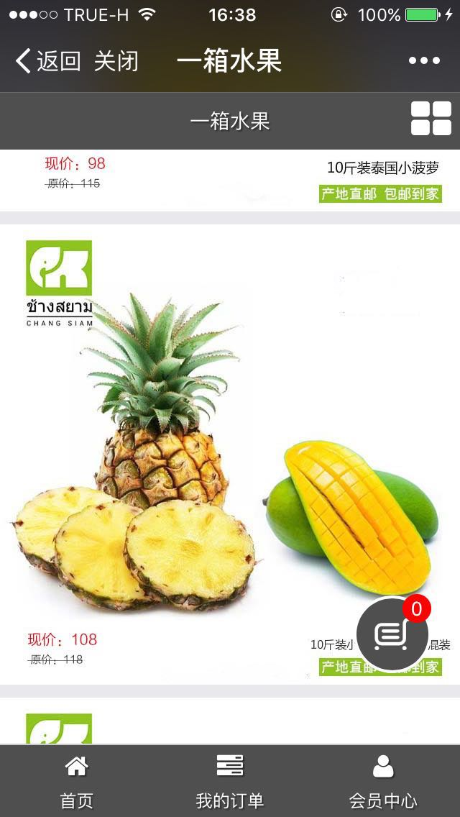
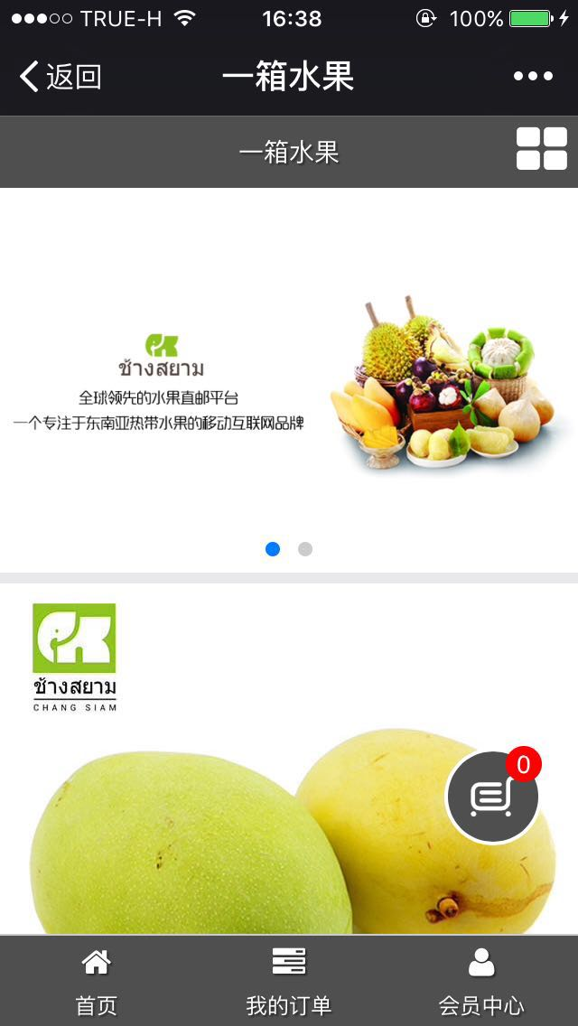
Official Service Account

Slide 15
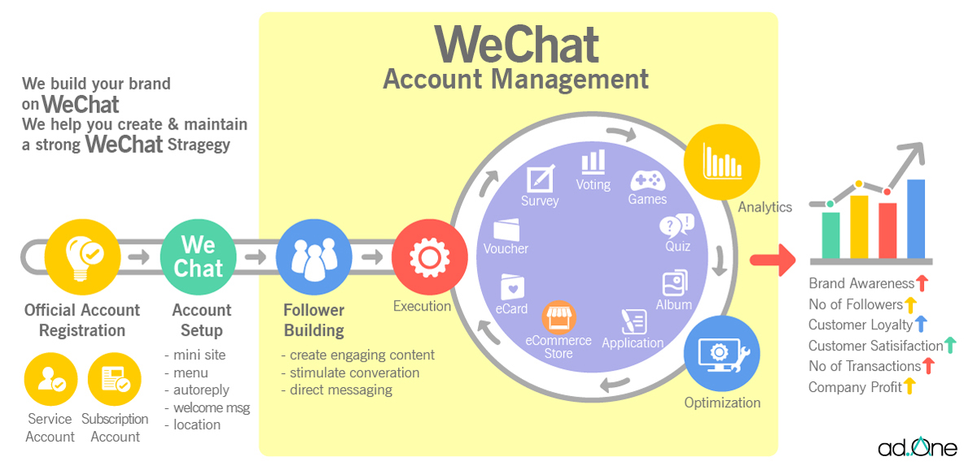
How the Official Account Support Online Marketing

Slide 16
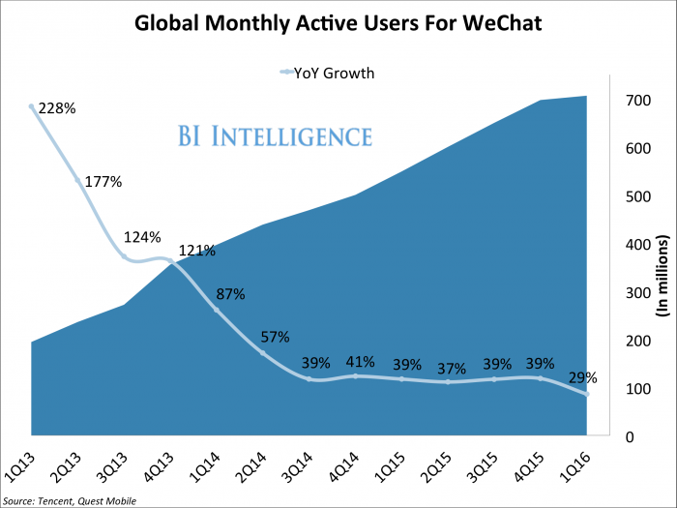
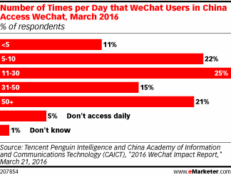
Why we chat official account

Slide 17
Do anyone can have an official account?
People | Subscription account | Service account
Chinese Mainland | Yes | No (if want ,need by agency company）
Overseas | No | No
Chinese Company | Yes | Yes
Overseas’ company | yes (but if want ,need by agency company) | yes (but if want ,need by agency company)

Slide 18
Why not anyone can has a official account ?
China identify card
We chat which already Binding China bank card
China company

Slide 19
China Intelligence Center (CIC)
中国商务智能中心
CAMT
053-920299 ext. 302
Director : ดร.ดนัยธัญ พงษ์พัชราธรเทพ
Email: danaitun.p@cmu.ac.th
MB: 081-746-6285
Director assistant : Qingwei Shen (น้ำ)
Email: shenqingwei@Hotmail.com
MB: 099-372-0099

Slide 20
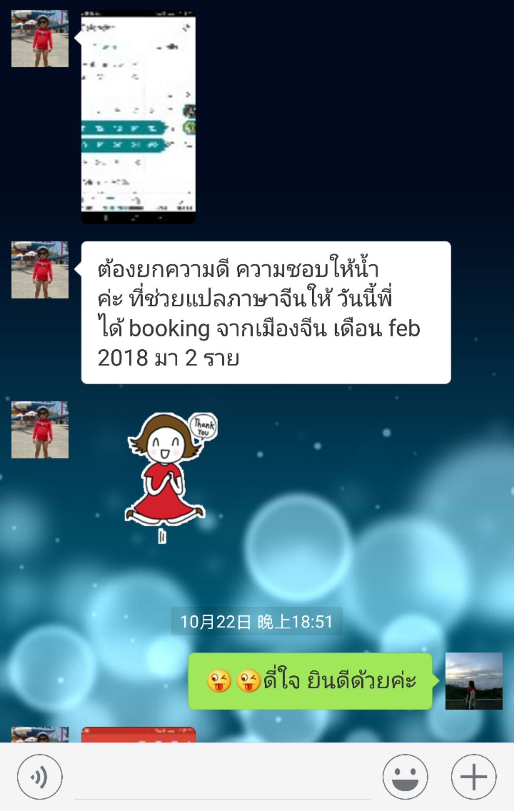
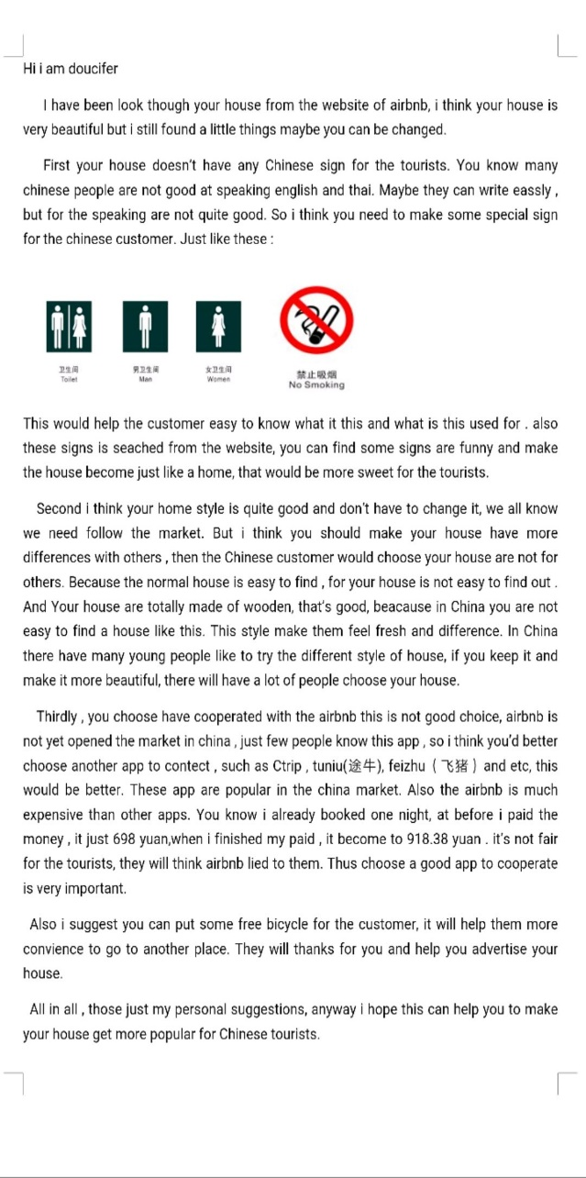
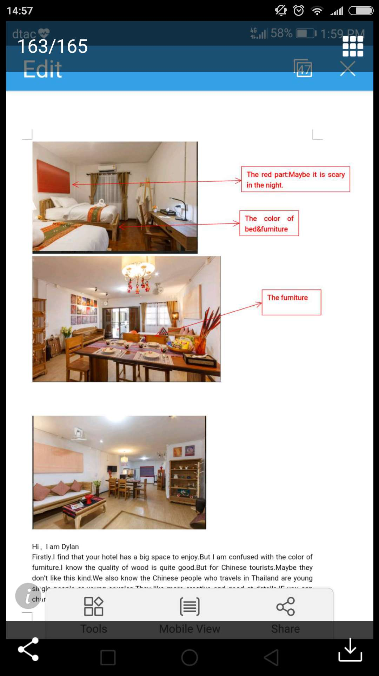
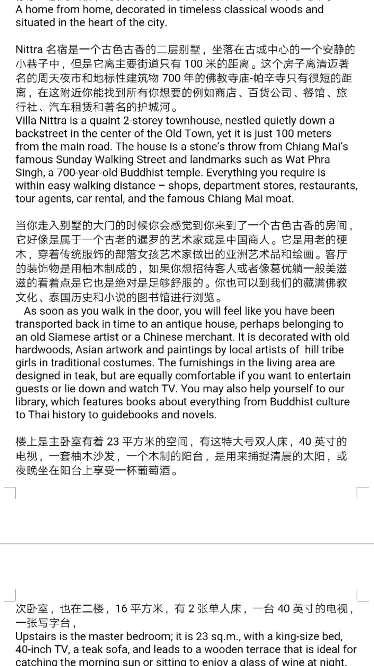
CIC Work Shows
Consultant
Chinese PR content
feedback

Slide 21
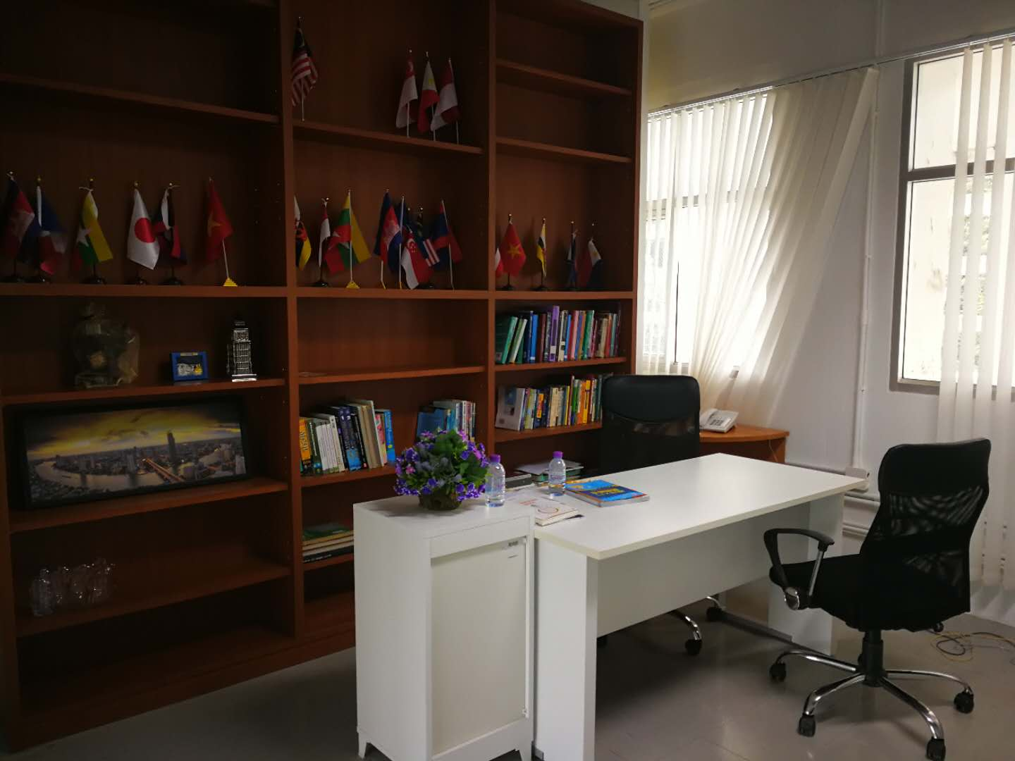
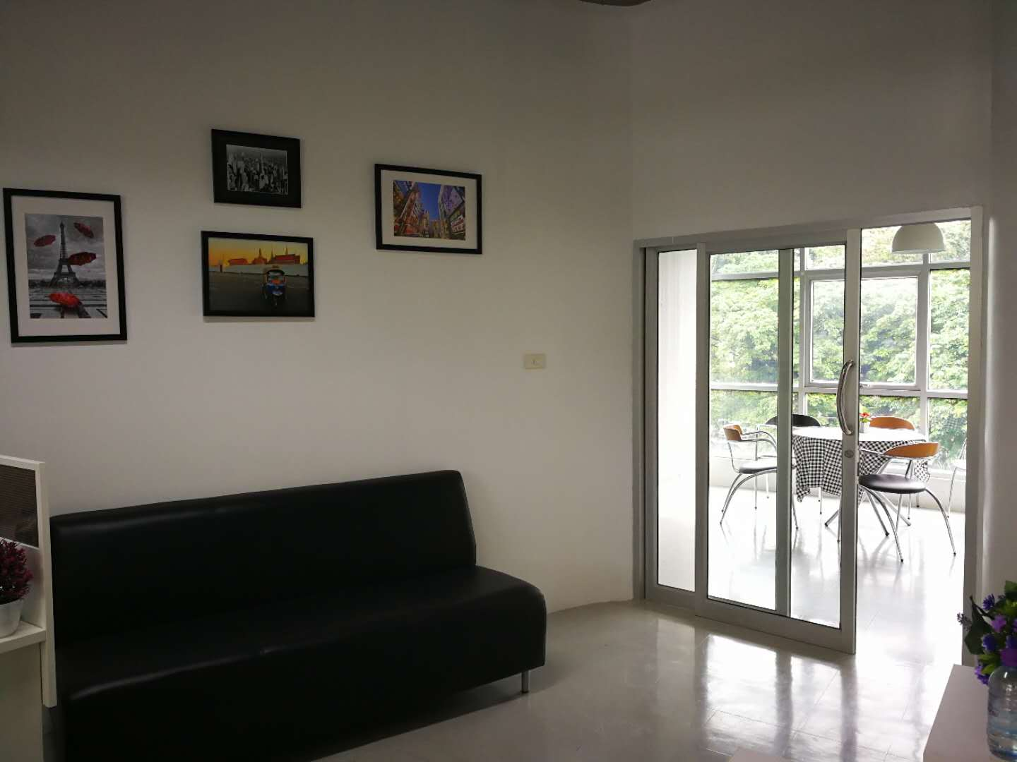
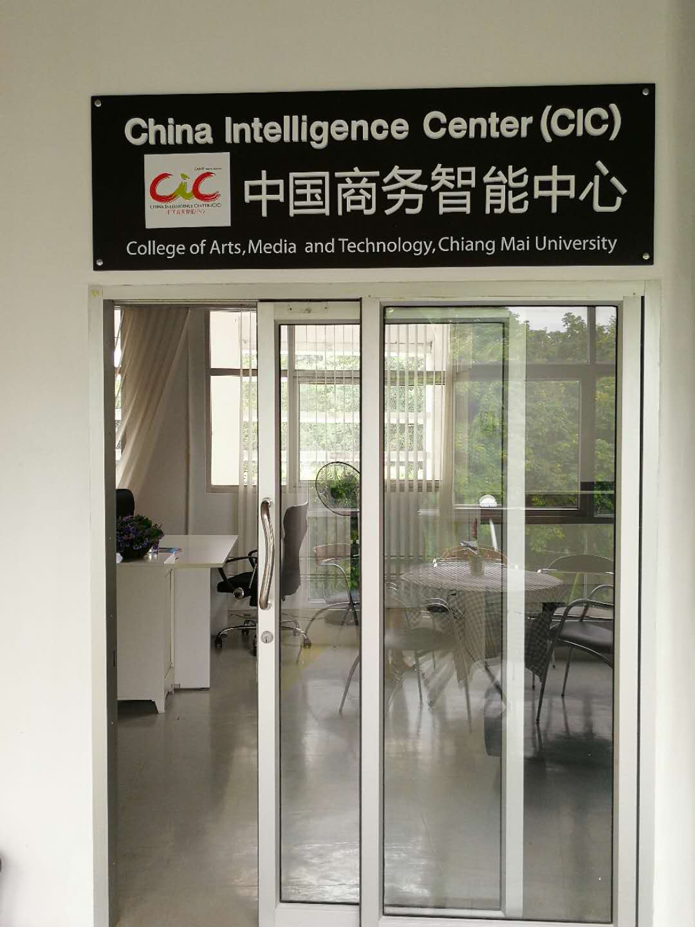
Email:
danaitun.p@cmu.ac.th
MB: 0817466285
qingwei_s@camu.ac.th
MB: 0993720099

Slide 22
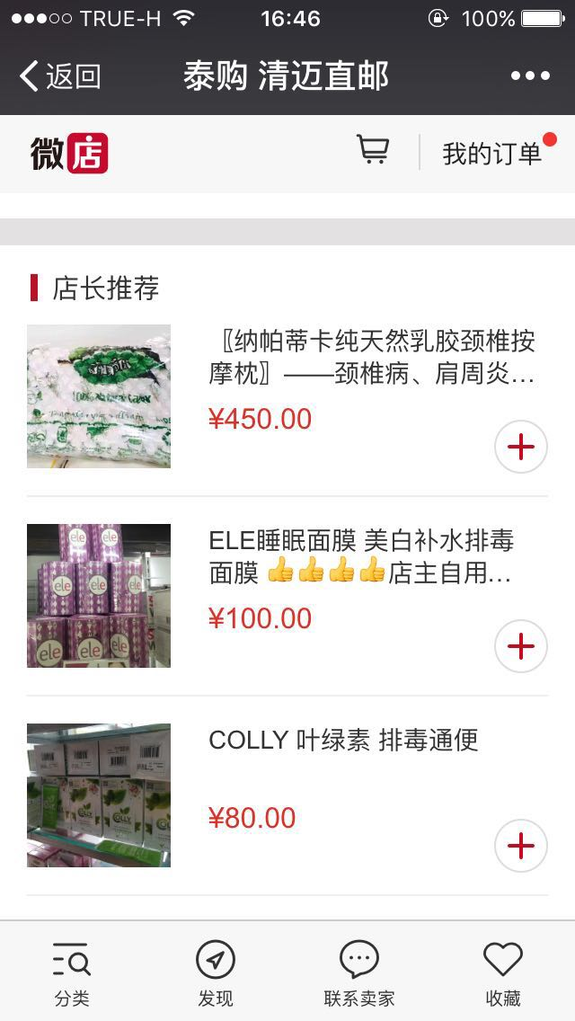
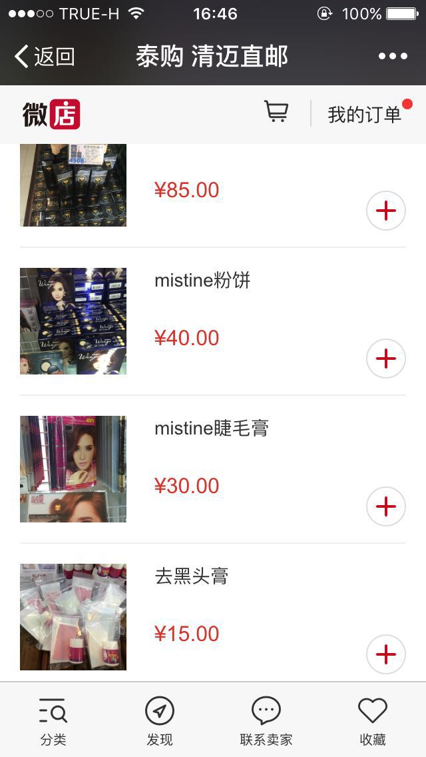
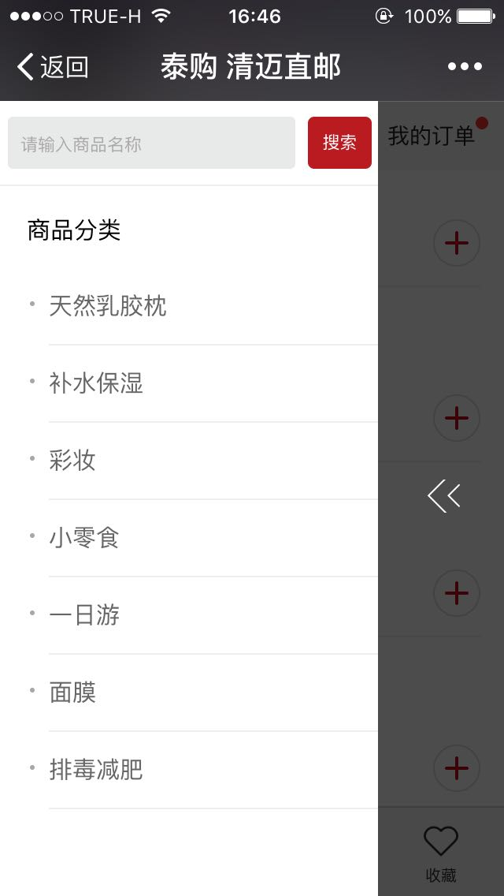
WeChat Micro Shop

Slide 23
WeChat Micro Shop
Wechat Micro shop: “Micro “means no need find cash flow ,goods supply , logistic flow and customer service by self. Just need give a suitable definition and price, as for promote just give the whole country Micro Shop and some social media to promote

Slide 24
Traditional business VS. Micro shop business
Traditional business
Micro shop business
Advantage 1：model B2C2C，good promote channel
Advantage 2：Combine emotions and interests, rebuild fans' word-of-mouth marketing and expand brand awareness.
product
product
Promote platform
Micro shop cloud Cloud portfolio
Micro shop
Micro shop
Micro shop
Micro shop
Micro shop
Solve supply and promoting by self
Promoting by the whole other Micro shop
Notes:
http://www.tmtpost.com/102495.html
微店网商业模式探究http://cd.qq.com/a/20140123/016174.htm

Slide 25
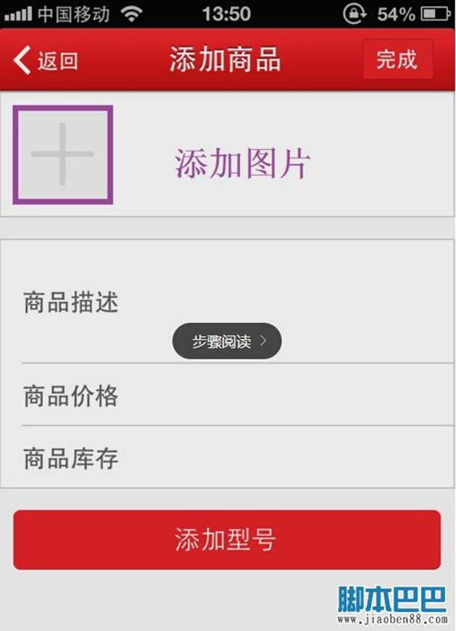
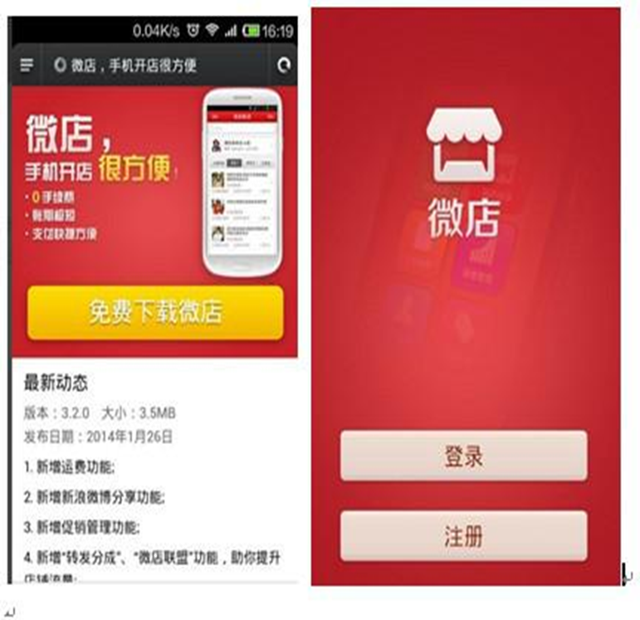
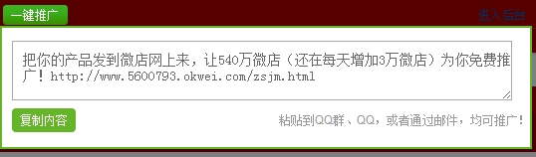
微店推广
First step
Apply Micro shop
Second step
Upload or find the agent product
Third step
Promote the Micro shop

Slide 26
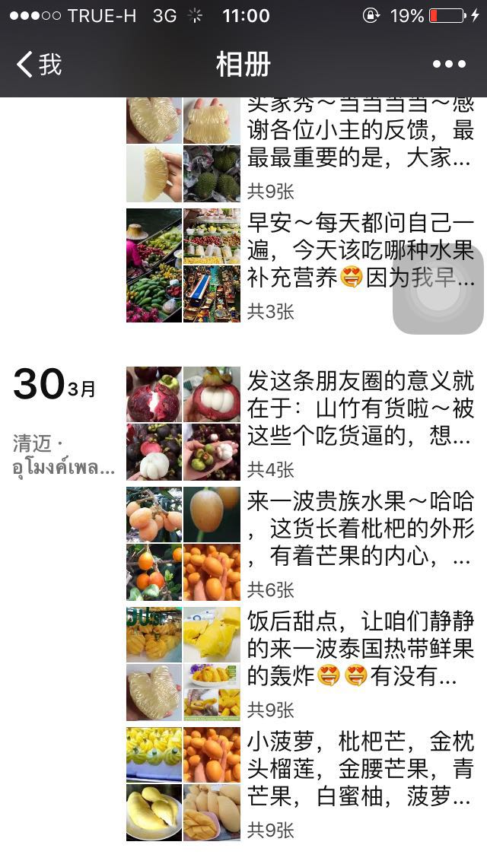
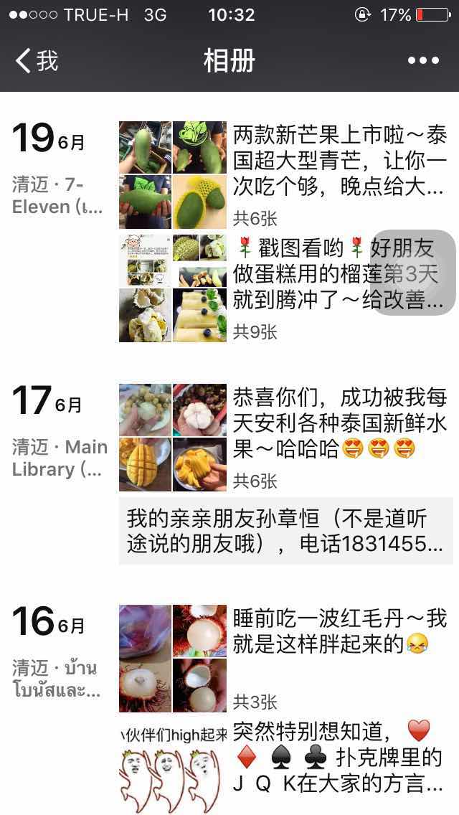
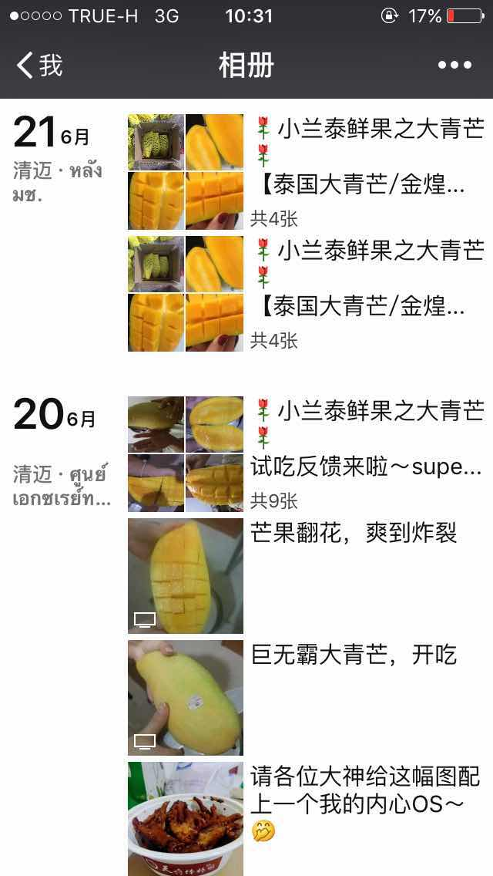
WeChat Moments

Slide 27


What is Microboss(WeiShang)?

Slide 28
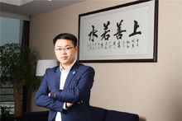
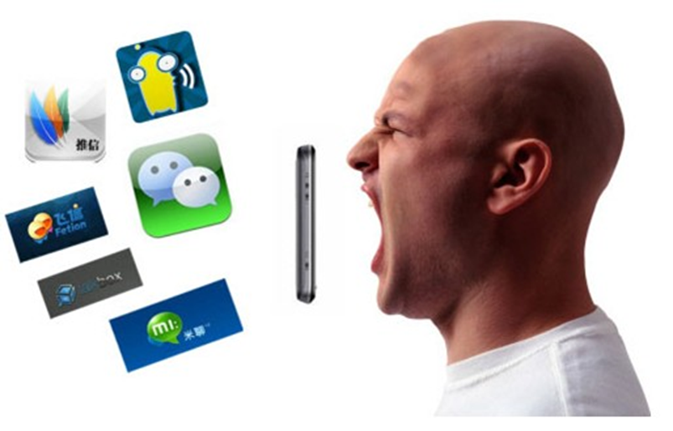
What is Weishang?
1.Definition
Generally speaking,Microboss is a new E-commerce model,that enterprise and personal do business through socialized media.
Narrowly speaking,Microboss is based on WeChat app which install in mobile and social integration as a new model of
E- ecommerce.
Micro-CEO Sun Taoyong

Slide 29
2.Microboss Business Model
B2C by WeChat official account
Microboss
Business model
C2C by WeChat
personal account

Slide 30
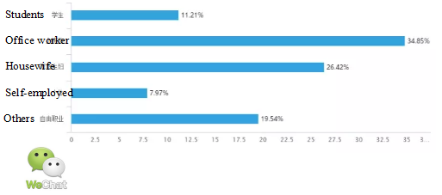
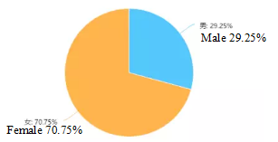
3.Microboss Analysis
(1)Occupation Analysis
(2)Gender Analysis
Most of them don't have a job or have enough free time.
The situation is from housewife as main force to men.

Slide 31
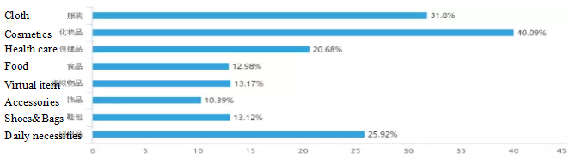
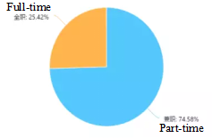
(3)Time Arrangement Analysis
(4)Popular Product Analysis
Most of them spend free time to run their business.
Popular product is something which is easy to show and neccessary for most people.

Slide 32
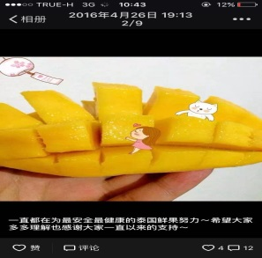
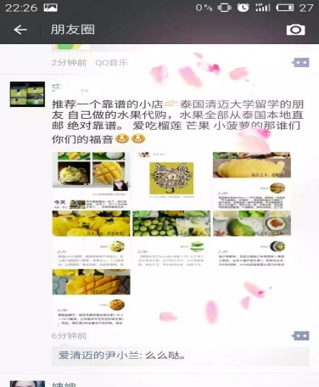
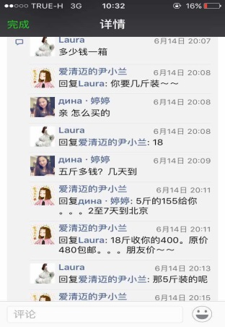
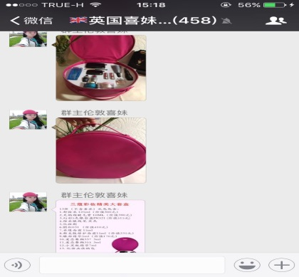
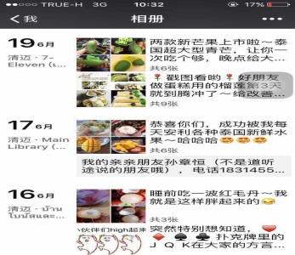
the business model cycle
4.Business Process
To attract potential customer attention
By wechat comments and official account
Have motivation to buy the product
By knowing the products
Experience product
CRM
According the consumer prefer products, send the relative product to relative consumer
Customers sharing feedback
By wechat comments

Slide 33





5.Logistics
Famous express company of China

Slide 34
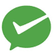

Microboss
Official Account
Information flow
WeChat micro shop
WeChat moments
Fund flow
China: wechat pay+alipay+E-bank
Thai: Alipay + E-bank
China : 1. pravate express company
2. government express orgnizations
Physical flow
Thai : 1. truck (R3A)
2. China's express delivery company

Slide 35
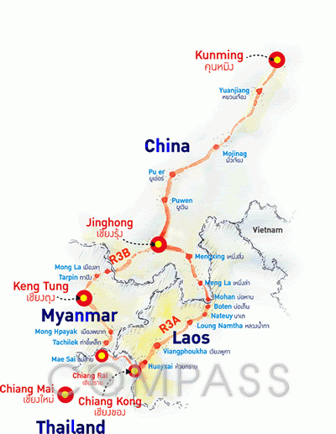
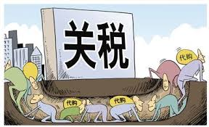
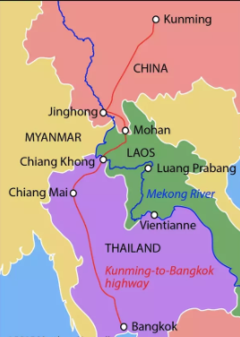
6.Why is there “Thai Delegated Purchase”?
•Low tax rate: The tax rate of cosmetic and luxury is over 50% in
China;
•Good image and concept: natural and safe;
•Convenient transportation:Kunming - Bangkok Road;
•Microboss and online shopping development.

Slide 36
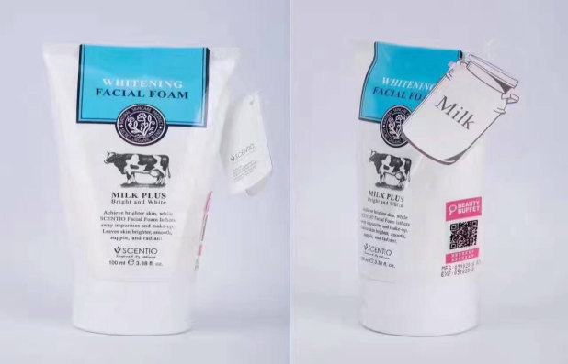

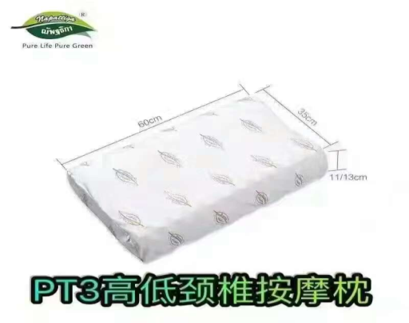
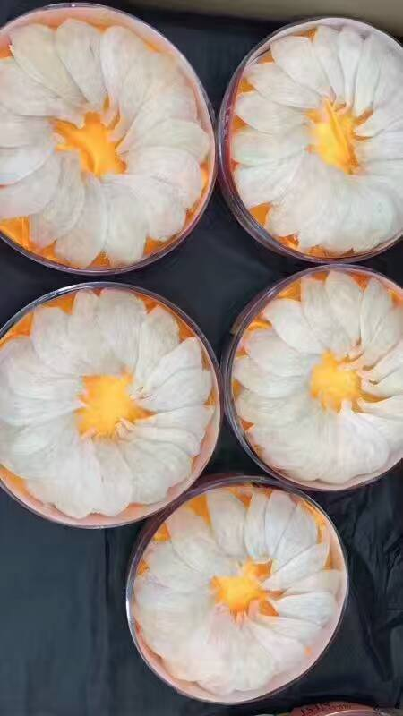
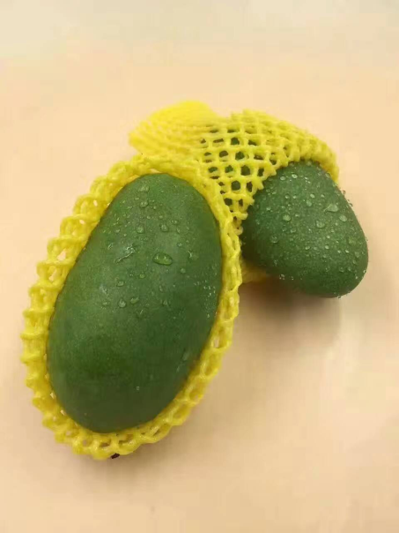

7.What are popular Thai goods?
Natural Cosmetic Medicine Latex Pillow
Bird nest Fruit Handicraft
(4)Cubilose (5)Fruit (6)Handicraft

Slide 37
8.How to do Micro boss of Thai
Product in Wechat?
•Find trustful supplier
①Cheaper price;
②High quality is basic to purchasing service;
③To provide professional knowledge, promotion and social skills.
•Post the content including pictures and words
①Post advertising on friend circle (moments);
②Share some Thai tourism,culture, and life knowledge.
•Promote to get more customers
Go to some social media such as forum, weibo to share
something that people need,to be professional to attract
customers and recognize you.

Slide 38
How to do Microboss?

Slide 39
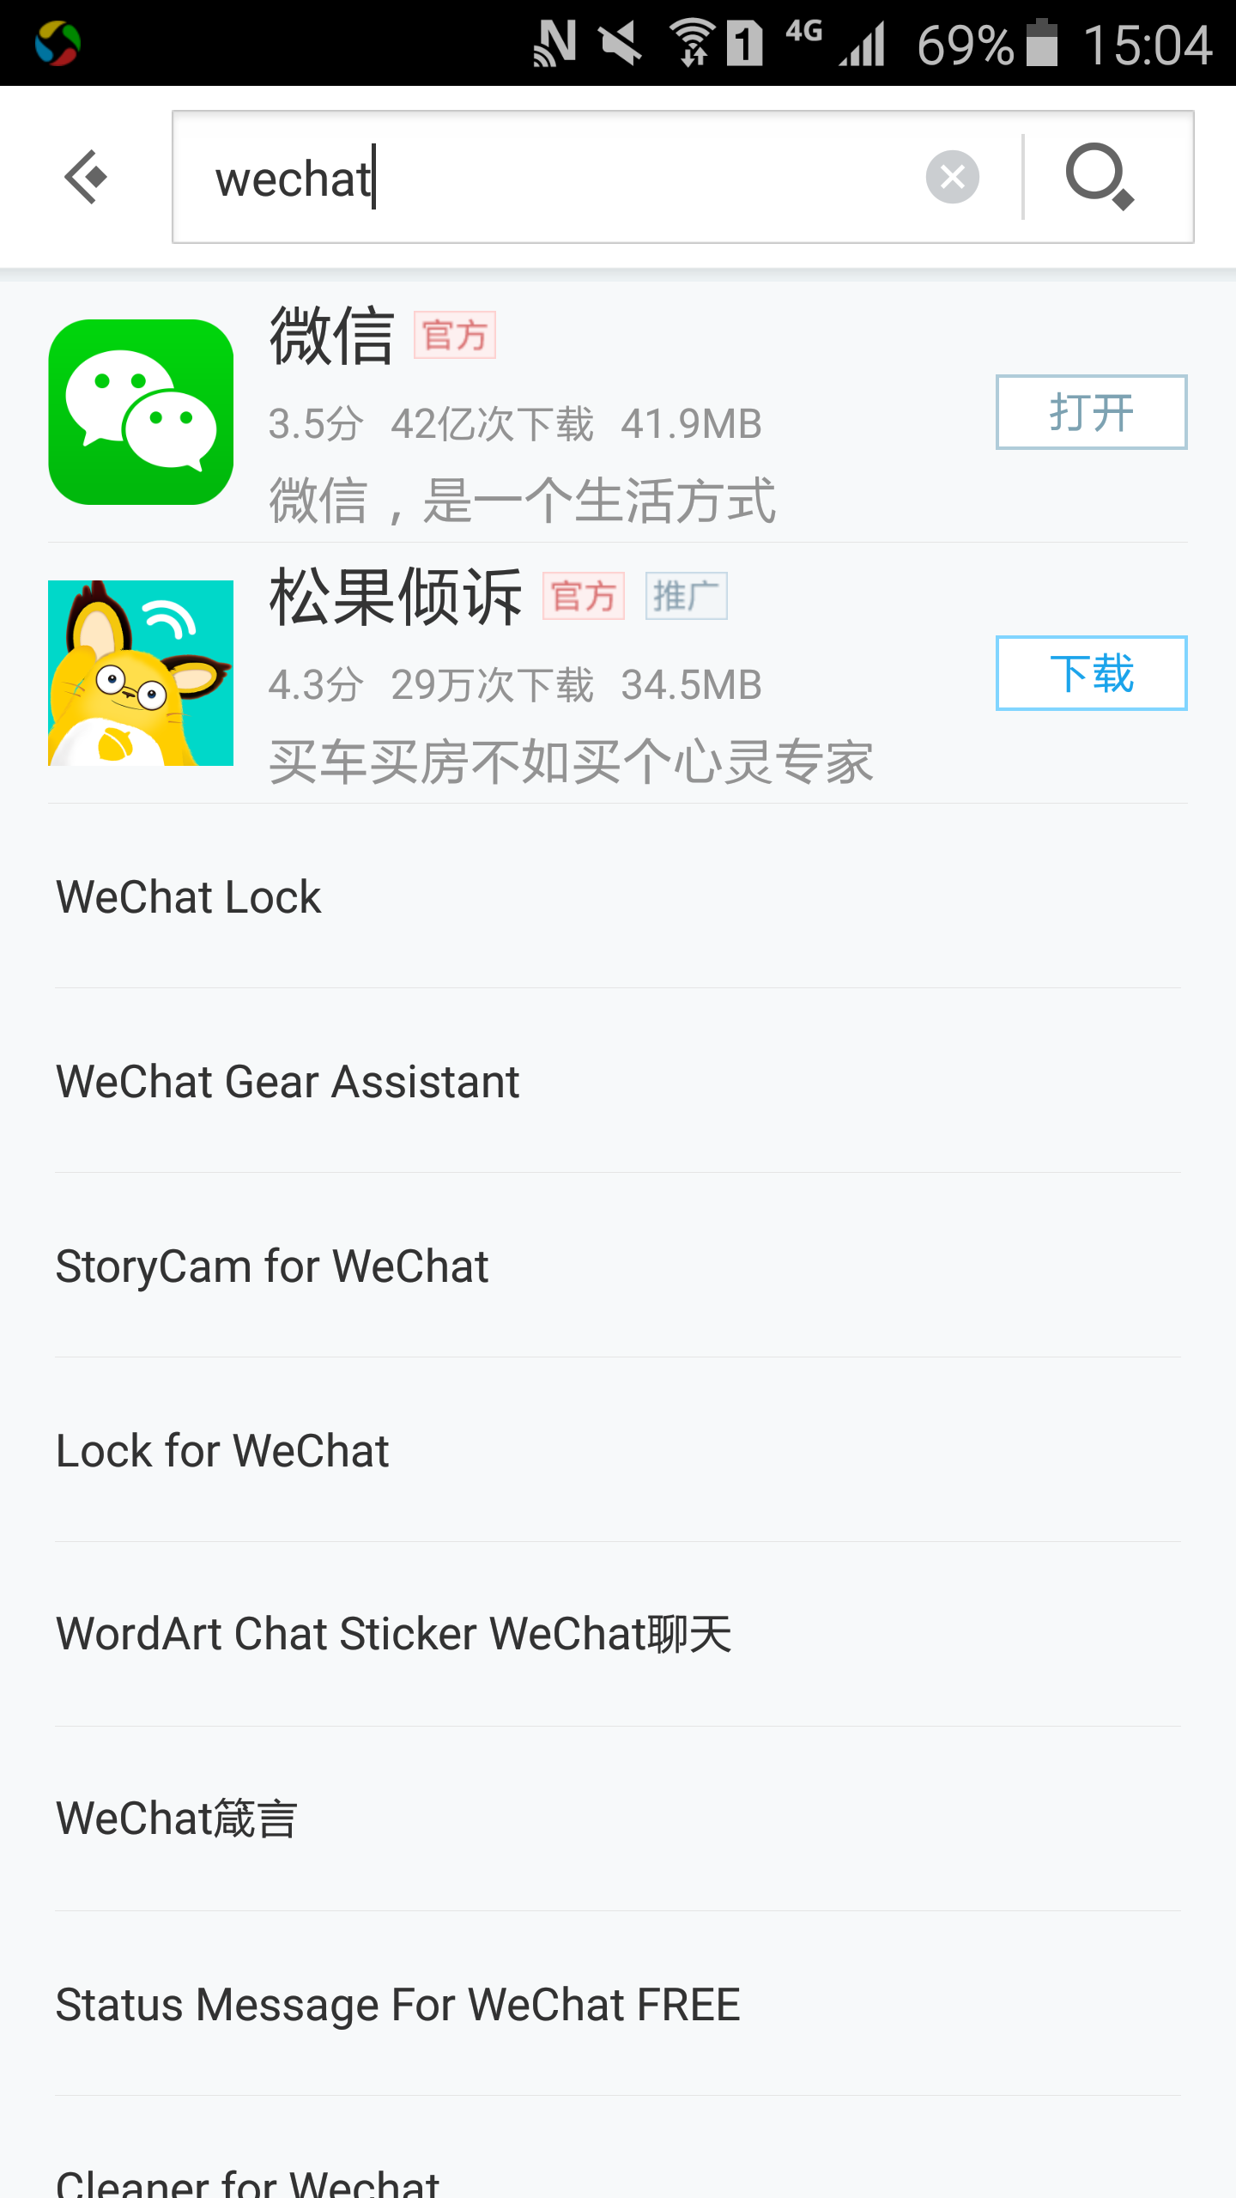



Part 1. Registration one Wechat Account
Step 1:Download the Wechat app
Wechat logo
Wechat logo
Find a APP store
Find a APP store
Input “wechat”
Open wechat
Input “wechat”

Slide 40



Step 2:Input your Wechat name,country,telephone,password
Input your name (internet/real),photo,coutry,telephone,password,then sign us
Once you sign up,the next time you log in,it can show your accout automatically,just input the password is ok.
Input your name (internet/real),photo,coutry,telephone,password,then sign us
Once you sign up,the next time you log in,it can show your accout automatically,just input the password is ok.
Registration Success
Log in wechat
Log in wechat

Slide 41



Part 2. Add New Customer
1
2
3
4
5
Chats interface
Button ” +” to add new friends
There are 5 ways from “add contacts ”
There are 5 ways from “add contacts ”
Chats interface
Button ” +” to add new friends

Slide 42



Way 1:Friend Radar
Way 1:Friend Radar
Click “Friends radar” button
Searching
Friend nearby
show in inteerface

Slide 43


Way 2:Join private group
Way 2:Join private group
Click “Join private group” button
Input the number you like
Click “Join this group” button
Join into group

Slide 44




Way 3:Scan QR Code
Way 3:Scan QR Code
Click “Scan QR code” button
Scan interface
QR code
Scan QR code and add friends

Slide 45




Way 4:Mobile contact
Way 4:Mobile contact
Flora & Elena
Click “Moble contact” button
Choose “mobile contact”
Choose “upload contacts”
Add friends

Slide 46



Way 4:Mobile contact--change your registration phone number
Way 4:Mobile contact--change your registration phone number
Choose “change moible”
Input new telephone number and get the veryfication code
Input veryfication code
Click “done” button,Change mobile successfully

Slide 47




Way 5:Official accounts
Way 5:Official accounts
Choose “Official account”
Input the name you are interested
Find the official account
Follow as friends

Slide 48





Part.3 Post Production Information
Max: 9 pictures
Max: 10 seconds

Slide 49



3.1 Post pictur and information
Find “me”column,and find the “album” button
Click camera button
Click “Chosse image”

Slide 50



Select the photos you want to post
Edit the promotion words and expression
Post successfully

Slide 51




3.2 Post video
Flora & Elena
Click “use camera” button
Hold the record butoon
Choose correct
Post successfully

Slide 52



Part 4. Get order
Flora & Elena
Communicate with customer
Transfer the money to wechat balance
Business Success

Slide 53




* How to withdraw the money ?
Click the “card”
Verify with the password
Input your bank card
*Must be Chinese card
Receive the verification code and bind the card success

Slide 54





Part 5. Deliver the goods
Flora & Elena
Pack packaging
Get the package tracking number
Send the package number to customer
Goods tracking

Slide 55
Thanks！
智慧金市场部

